Slide 1
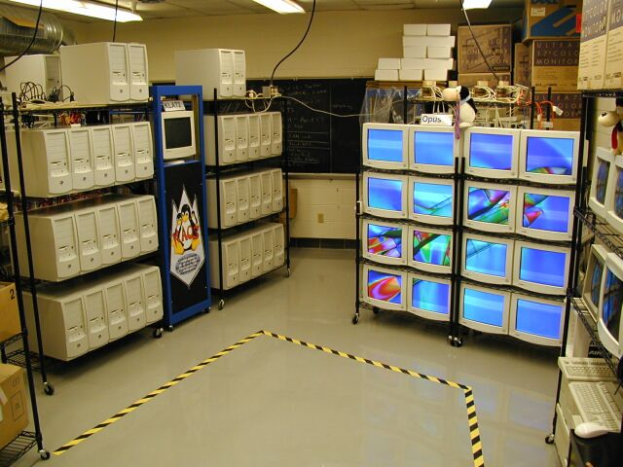
Introduction to
Parallel Computing with MPI
Chunfang Chen, Danny Thorne, Muhammed Cinsdikici

Slide 2
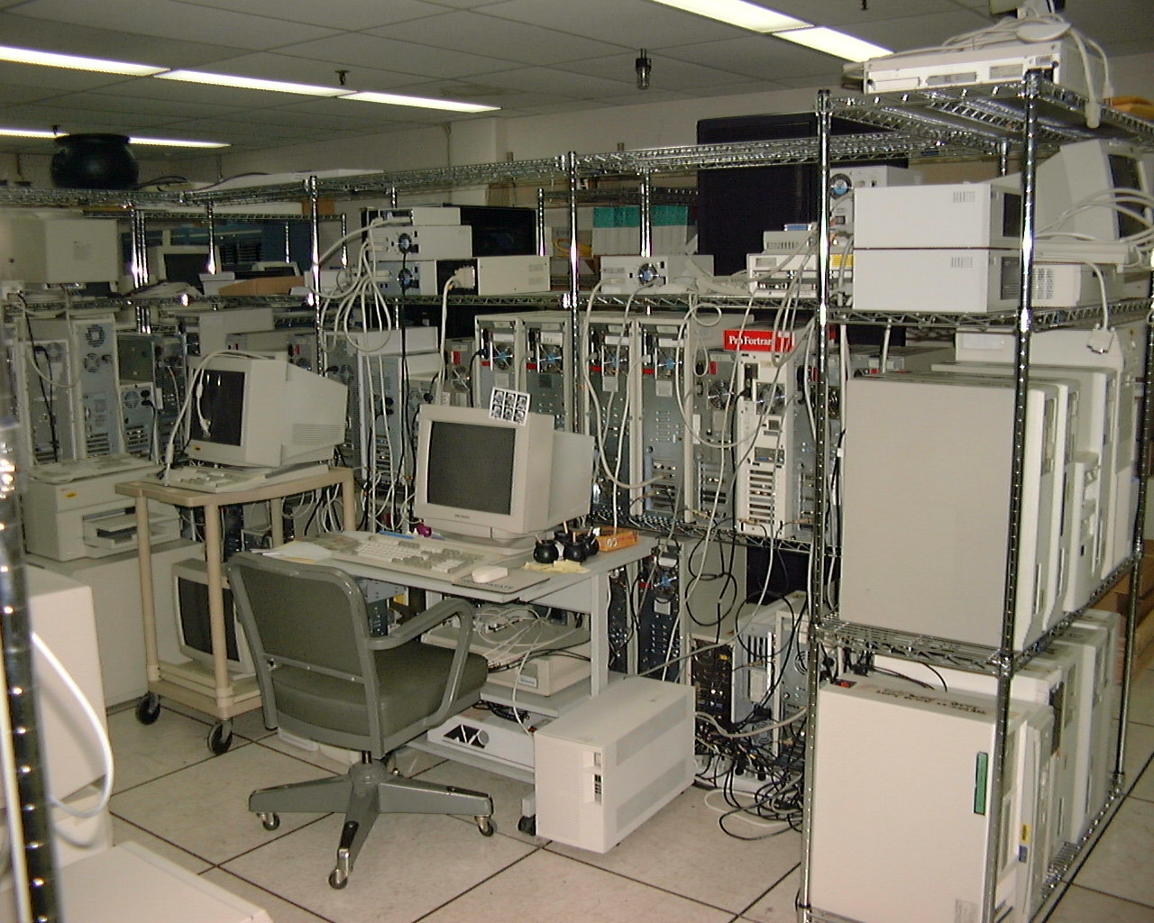
Introduction to MPI

Slide 3
Outline
Introduction to Parallel Computing,
    by Danny Thorne
Introduction to MPI,
    by Chunfang Chen and Muhammed Cimsdikici
Writing MPI
Compiling and linking MPI programs
Running MPI programs
Sample C program codes for MPI,
    by Muhammed Cinsdikici

Slide 4
Writing MPI Programs
All MPI programs must include a header file. In C: mpi.h, in fortran: mpif.h
All MPI programs must call MPI_INIT as the first MPI call. This establishes the MPI environment.
All MPI programs must call MPI_FINALIZE as the last call, this exits MPI.
Both MPI_INIT & FINALIZE returns MPI_SUCCESS if they are successfuly exited

Slide 5
Program: Welcome to MPI
#include<stdio.h>
#include<mpi.h>
int main(int argc, char *argv[]){
int rank,size;
MPI_Init(&argc,&argv);
MPI_Comm_rank(MPI_COMM_WORLD,&rank);
MPI_Comm_size(MPI_COMM_WORLD,&size);
printf("Hello world, I am: %d of the nodes: %d\n", rank,size);
MPI_Finalize();
return 0;
}

Slide 6
Commentary
Only one invocation of MPI_INIT can occur in each program
It’s only argument is an error code (integer)
MPI_FINALIZE terminates the MPI environment ( no calls to MPI can be made after MPI_FINALIZE is called)
All non MPI routine are local; i.e. printf (“Welcome to MPI”) runs on each processor

Slide 7
Compiling MPI programs
In many MPI implementations, the program can be compiled as
mpif90 -o executable program.f
mpicc -o executable program.c
mpif90 and mpicc transparently set the include paths and links to appropriate libraries

Slide 8
Compiling MPI Programs
mpif90 and mpicc can be used to compile small programs
For larger programs, it is ideal to make use of a makefile

Slide 9
Running MPI Programs
mpirun -np 2 executable
- mpirun indicate that you are using the
MPI environment.
- np is the number of processors you
like to use ( two for the present case)
mpirun -C executable
- C is for all of the processors you like to use

Slide 10
Sample Output
Sample output when run over 2 processors will be
Welcome to MPI
Welcome to MPI
Since Printf(“Welcome to MPI”) is local statement, every processor execute it.

Slide 11
Finding More about Parallel Environment
Primary questions asked in parallel program are
- How many processors are there?
- Who am I?
How many is answered by MPI_COMM_SIZE
Who am I is answered by MPI_COMM_RANK

Slide 12
How Many?
Call MPI_COMM_SIZE(mpi_comm_world, size)
- mpi_comm_world is the communicator
- Communicator contains a group of processors
- size returns the total number of processors
- integer size

Slide 13
Who am I?
The processors are ordered in the group consecutively from 0 to size-1, which is known as rank
Call MPI_COMM_RANK(mpi_comm_world,rank)
- mpi_comm_world is the communicator
- integer rank
- for size=4, ranks are 0,1,2,3

Slide 14

Communicator
MPI_COMM_WORLD
1
0
2
3

Slide 15
Program: Welcome to MPI
#include<stdio.h>
#include<mpi.h>
int main(int argc, char *argv[]){
int rank,size;
MPI_Init(&argc,&argv);
MPI_Comm_rank(MPI_COMM_WORLD,&rank);
MPI_Comm_size(MPI_COMM_WORLD,&size);
printf("Hello world, I am: %d of the nodes: %d\n", rank,size);
MPI_Finalize();
return 0;
}

Slide 16
Sample Output
# mpicc hello.c -o hello
# mpirun -np 6 hello
Hello world, I am: 0 of the nodes: 6
Hello world, I am: 1 of the nodes: 6
Hello world, I am: 2 of the nodes: 6
Hello world, I am: 4 of the nodes: 6
Hello world, I am: 3 of the nodes: 6
Hello world, I am: 5 of the nodes: 6

Slide 17
Sending and Receiving Messages
Communication between processors involves:
- identify sender and receiver
- the type and amount of data that is being sent
- how is the receiver identified?

Slide 18
Communication
Point to point communication
- affects exactly two processors
Collective communication
- affects a group of processors in the communicator

Slide 19
Point to point Communication
MPI_COMM_WORLD
1
0
2
3

Slide 20
Point to Point Communication
Communication between two processors
source processor sends message to destination processor
destination processor receives the message
communication takes place within a communicator
destination processor is identified by its rank in the communicator

Slide 21
Communication mode (Fortran)
Synchronous send(MPI_SSEND)
buffered send
(MPI_BSEND)
standard send
(MPI_SEND)
receive(MPI_RECV)
Only completes when the receive has completed
Always completes (unless an error occurs), irrespective of receiver
Message send(receive state unknown)
Completes when a message had arrived

Slide 22
Send Function
int MPI_Send(void *buf, int count, MPI_Datatype datatype,
int dest, int tag, MPI_Comm comm)
- buf is the name of the array/variable to be broadcasted
- count is the number of elements to be sent
- datatype is the type of the data
- dest is the rank of the destination processor
- tag is an arbitrary number which can be used to
distinguish different types of messages (from 0 to MPI_TAG_UB max=32767)
- comm is the communicator( mpi_comm_world)

Slide 23
Receive Function
int MPI_Recv(void *buf, int count, MPI_Datatype datatype,
int source, int tag, MPI_Comm comm, MPI_Status *status)
- source is the rank of the processor from which data will
be accepted (this can be the rank of a specific
processor or a wild card- MPI_ANY_SOURCE)
- tag is an arbitrary number which can be used to
distinguish different types of messages (from 0 to MPI_TAG_UB max=32767)

Slide 24
MPI Receive Status
Status is implemented as structure with three fields;
Typedef struct MPI_Status
  {
    Int MPI_SOURCE;
    Int MPI_TAG;
    Int MPI_ERROR;
    }
Also Status shows message length, but it has no direct access.
In order to get the message length, the following function is called;
Int MPI_Get_count(MPI_Status *status, MPI_Datatype datatype, int *count)

Slide 25
Basic data type (C)
MPI_CHAR
MPI_SHORT
MPI_INT
MPI_LONG
MPI_UNSIGNED_CHAR
MPI_UNSIGNED_SHORT
MPI_UNSIGNED
MPI_UNSIGNED_LONG
MPI_FLOAT
MPI_DOUBLE
MPI_LONG_DOUBLE
Signed Char
Signed Short Int
Signed Int
Signed Long Int
Unsigned Char
Unsigned Short Int
Unsigned Int
Unsigned Long Int
Float
Double
Long Double

Slide 26
Sample Code with Send/Receive
/*An MPI sample program (C)*/
#include <stdio.h>
#include "mpi.h"
main(int argc, char **argv)
{
int rank, size, tag, rc, i;
MPI_Status status;
char message[20];
rc = MPI_Init(&argc, &argv);
rc = MPI_Comm_size(MPI_COMM_WORLD, &size);
rc = MPI_Comm_rank(MPI_COMM_WORLD, &rank);

Slide 27
Sample Code with Send/Receive (cont.)
tag = 100;
if(rank == 0) {
strcpy(message, "Hello, world");
for (i=1; i<size; i++)
rc = MPI_Send(message, 13, MPI_CHAR, i, tag, MPI_COMM_WORLD);
}
else
rc = MPI_Recv(message, 13, MPI_CHAR, 0, tag, MPI_COMM_WORLD, &status);
printf( "node %d : %.13s\n", rank,message);
rc = MPI_Finalize();
}

Slide 28
Sample Output
# mpicc hello2.c -o hello2
# mpirun -np 6 hello2
node 0 : Hello, world
node 1 : Hello, world
node 2 : Hello, world
node 3 : Hello, world
node 4 : Hello, world
node 5 : Hello, world

Slide 29
Sample Code Trapezoidal
/* trap.c -- Parallel Trapezoidal Rule, first version
* 1. f(x), a, b, and n are all hardwired.
* 2. The number of processes (p) should evenly divide
* the number of trapezoids (n = 1024) */
#include <stdio.h>
#include "mpi.h"
main(int argc, char** argv) {
int my_rank; /* My process rank */
int p; /* The number of processes */
float a = 0.0; /* Left endpoint */
float b = 1.0; /* Right endpoint */
int n = 1024; /* Number of trapezoids */
float h; /* Trapezoid base length */
float local_a; /* Left endpoint my process */
float local_b; /* Right endpoint my process */
int local_n; /* Number of trapezoids for */

Slide 30
Sample Code Trapezoidal
float integral; /* Integral over my interval */
float total; /* Total integral */
int source; /* Process sending integral */
int dest = 0; /* All messages go to 0 */
int tag = 0;
float Trap(float local_a, float local_b, int local_n, float h);
MPI_Status status;
MPI_Init(&argc, &argv);
MPI_Comm_rank(MPI_COMM_WORLD, &my_rank);
MPI_Comm_size(MPI_COMM_WORLD, &p);
h = (b-a)/n; /* h is the same for all processes */
local_n = n/p; /* So is the number of trapezoids */
local_a = a + my_rank*local_n*h;
local_b = local_a + local_n*h;
integral = Trap(local_a, local_b, local_n, h);
if (my_rank == 0) {
total = integral;

Slide 31
Sample Code Trapezoidal
for (source = 1; source < p; source++) {
MPI_Recv(&integral, 1, MPI_FLOAT, source, tag, MPI_COMM_WORLD, &status);
printf ("Ben rank=0,%d'den aldigim sayi %f \n",source,integral);
total = total + integral;
}
} else {
printf ("Ben %d, gonderdigim sayi %f \n",my_rank,integral);
MPI_Send(&integral, 1, MPI_FLOAT, dest, tag, MPI_COMM_WORLD);
}
if (my_rank == 0) {
printf("With n = %d trapezoids, our estimate\n",
n);
printf("of the integral from %f to %f = %f\n",
a, b, total);
}
MPI_Finalize();
} /* main */

Slide 32
Sample Code Trapezoidal
float Trap(
float local_a /* in */, float local_b /* in */,
int local_n /* in */, float h /* in */) {
float integral; /* Store result in integral */
float x; int i;
float f(float x); /* function we're integrating */
integral = (f(local_a) + f(local_b))/2.0;
x = local_a;
for (i = 1; i <= local_n-1; i++) { x = x + h; integral = integral + f(x); }
integral = integral*h;
return integral;
} /* Trap */
float f(float x) {
float return_val;
return_val = x*x;
return return_val;
} /* f */

Slide 33
Sendrecv Function
MPI_Sendrecv function that both sends and receives a message.
MPI_Sendrecv does not suffer from the circular deadlock problems of MPI_Send and MPI_Recv.
You can think of MPI_Sendrecv as allowing data to travel for both send and receive simultaneously.
The calling sequence of MPI_Sendrecv is the following:
int MPI_Sendrecv(void *sendbuf, int sendcount,
MPI_Datatype senddatatype, int dest, int sendtag,
void *recvbuf, int recvcount, MPI_Datatype recvdatatype,
int source, int recvtag, MPI_Comm comm,
MPI_Status *status)

Slide 34
Sendrecv_replace Function
In many programs, the requirement for the send and receive buffers of MPI_Sendrecv be disjoint may force us to use a temporary buffer. This increases the amount of memory required by the program and also increases the overall run time due to the extra copy.
This problem can be solved by using that MPI_Sendrecv_replace MPI function. This function performs a blocking send and receive, but it uses a single buffer for both the send and receive operation. That is, the received data replaces the data that was sent out of the buffer. The calling sequence of this function is the following:
int MPI_Sendrecv_replace(void *buf, int count,
MPI_Datatype datatype, int dest, int sendtag,
int source, int recvtag, MPI_Comm comm,
MPI_Status *status)
Note that both the send and receive operations must transfer data of the same datatype.

Slide 35
Resources
Online resources
  http://www-unix.mcs.anl.gov/mpi
  http://www.erc.msstate.edu/mpi
  http://www.epm.ornl.gov/~walker/mpi
  http://www.epcc.ed.ac.uk/mpi
  http://www.mcs.anl.gov/mpi/mpi-report-1.1/mpi-report.html
  ftp://www.mcs.anl.gov/pub/mpi/mpi-report.html

Slide 36
MPI Programming Part II

Slide 37
Blocking Send/Receive
(Non-Buffered)
If MPI_Send is blocking the following code shows DEADLOCK
int a[10], b[10], myrank;
MPI_Status status;
MPI_COMM_RANK(MPI_COMM_WORLD, &myrank);
if (myrank == 0)
  {
  MPI_Send(a, 10, MPI_INT, 1, 1, MPI_COMM_WORLD);
  MPI_Send(b, 10, MPI_INT, 1, 2, MPI_COMM_WORLD);
  }
else if (myrank == 1)
  {
  MPI_Recv(b, 10, MPI_INT, 0, 2, MPI_COMM_WORLD);
  MPI_Recv(a, 10, MPI_INT, 0, 1, MPI_COMM_WORLD);
  }
- MPI_Send can be blocking or non-blocking
- MPI_Recv is blocking (waits until send is completed)
You can use the routine MPI_Wtime to time code in MPI The statement
t = MPI_Wtime();

Slide 38
As a Solution to DEADLOCK
Odd/Even Rank Isolation
Although MPI_Send can be blocking, odd/even rank isolation can solve some DEADLOCK situations
int a[10], b[10], npes, myrank;
MPI_Status status;
MPI_COMM_SIZE(MPI_COMM_WORLD, &npes);
MPI_COMM_RANK(MPI_COMM_WORLD, &myrank);
if (myrank%2 == 1)
{
MPI_Send(a, 10, MPI_INT, (myrank+1)%npes, 1, MPI_COMM_WORLD);
MPI_Recv(b, 10, MPI_INT, (myrank-1+npes)%npes, 1, MPI_COMM_WORLD);
}
else {
MPI_Recv(b, 10, MPI_INT, (myrank-1+npes)%npes, 1, MPI_COMM_WORLD);
MPI_Send(a, 10, MPI_INT, (myrank+1)%npes, 1, MPI_COMM_WORLD);
}
- MPI_Send can is blocking on above code.
- MPI_Recv is blocking (waits until send is completed)

Slide 39
As a Solution to DEADLOCK
Send & Recv Simultaneous
Although MPI_Send can be blocking, odd/even rank isolation can solve some DEADLOCK situations
int a[10], b[10], npes, myrank;
MPI_Status status;
MPI_COMM_SIZE(MPI_COMM_WORLD, &npes);
MPI_COMM_RANK(MPI_COMM_WORLD, &myrank);
MPI_SendRecv (a, 10, MPI_INT, (myrank+1)%npes, 1,
b, 10, MPI_INT, (myrank-1+npes)%npes, 1,
MPI_COMM_WORLD, &status);
MPI_SendRecv is blocking (waits until recv is completed)
A Variant is MPI_SendRecv_Replace (For point to point comm)

Slide 40
As a Solution to DEADLOCK
Non Blocking Send & Recv
int MPI_Isend (void *buf, int count, MPI_Datatype datatype, int dest,
int tag, MPI_Comm comm, MPI_Request *request)
int MPI_Irecv (void *buf, int count, MPI_Datatype datatype, int source,
int tag, MPI_Comm comm, MPI_Request *request)
MPI_ISEND, starts a send operation but does not completes, that is, it returns before the data is copied out of the buffer.
MPI_IRECV, starts a receive operations but returns before the data has been received and copied into the buffer.
A process that has started a non-blocking send or receive operation must make sure that it has completed before it can proceed with its computations.
For ensuring the completion of non-blocking send and receive operations, MPI provides a pair of functions MPI_TEST and MPI_WAIT.

Slide 41
As a Solution to DEADLOCK
Non Blocking Send & Recv (Cont.)
int MPI_Isend (void *buf, int count, MPI_Datatype datatype, int dest,
int tag, MPI_Comm comm, MPI_Request *request)
int MPI_Irecv (void *buf, int count, MPI_Datatype datatype, int source,
int tag, MPI_Comm comm, MPI_Request *request)
int MPI_Test(MPI_Request *request, int *flag, MPI_Status *status)
int MPI_Wait(MPI_Request *request, MPI_Status *status)
MPI_Isend and MPI_Irecv functions allocate a request object and return a pointer to it in the request variable.
This request object is used as an argument in the MPI_TEST and MPI_WAIT functions to identify the operation that we want to query about its status or to wait for its completion.

Slide 42
As a Solution to DEADLOCK
Non Blocking Send & Recv (Cont.)
if (myrank == 0)
    {
      MPI_Send(a, 10, MPI_INT, 1, 1, MPI_COMM_WORLD);
      MPI_Send(b, 10, MPI_INT, 1, 2, MPI_COMM_WORLD);
    }
else if (myrank == 1)
    {
      MPI_Recv(b, 10, MPI_INT, 0, 2, &status, MPI_COMM_WORLD);
      MPI_Recv(a, 10, MPI_INT, 0, 1, &status, MPI_COMM_WORLD);
    }
The DEADLOCK in above code is replaced with the code belov making it safer
MPI_Request requests[2];
if (myrank == 0)
    {
    MPI_Send(a, 10, MPI_INT, 1, 1, MPI_COMM_WORLD);
    MPI_Send(b, 10, MPI_INT, 1, 2, MPI_COMM_WORLD);
    }
else if (myrank == 1)
    {
    MPI_Irecv(b, 10, MPI_INT, 0, 2, &requests[0], MPI_COMM_WORLD);
    MPI_Irecv(a, 10, MPI_INT, 0, 1, &requests[1], MPI_COMM_WORLD);
    }

Slide 43
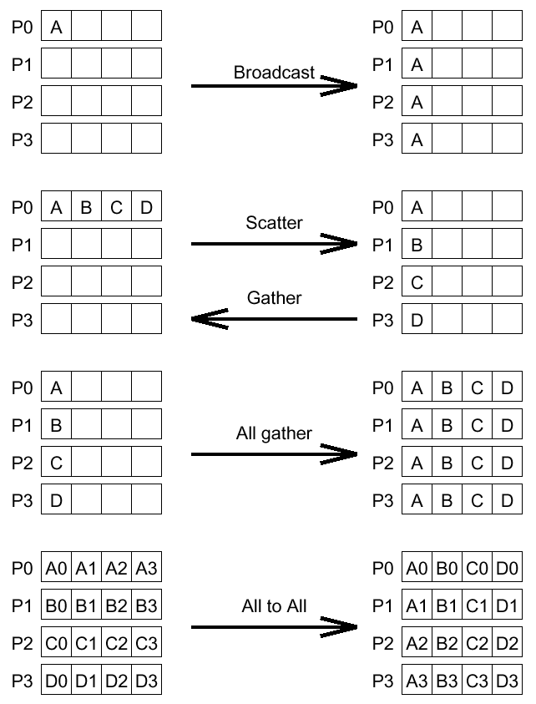
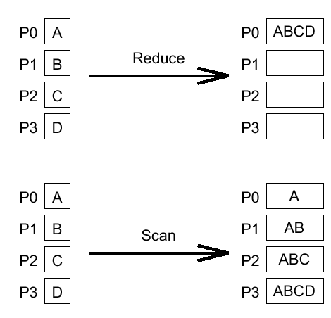
Collective Communication & Computation Operations
BARRIER
BROADCAST
REDUCTION
PREFIX
GATHER
SCATTER
ALL-to-ALL

Slide 44
BARRIER
The barrier synchronization operation is performed in MPI using the MPI_Barrier function.
int MPI_Barrier(MPI_Comm comm)
The only argument of MPI_Barrier is the communicator that defines the group of processes that are synchronized.
The call to MPI_Barrier returns only after all the processes in the group have called this function.

Slide 45
BROADCAST
The one-to-all broadcast operation is performed in MPI using the MPI_Bcast function.
int MPI_Bcast(void *buf, int count, MPI_Datatype datatype, int source, MPI_Comm comm)
MPI_Bcast sends the data stored in the buffer buf of process source to all the other processes in the group.
The data received by each process is stored in the buffer buf.
The data that is broadcast consist of count entries of type datatype. The amount of data sent by the source process must be equal to the amount of data that is being received by each process; i.e., the count and datatype fields must match on all processes.

Slide 46
REDUCTION
The all-to-one reduction operation is performed in MPI using the MPI_Reduce function.
int MPI_Reduce(void *sendbuf, void *recvbuf, int count, MPI_Datatype datatype, MPI_Op op, int target, MPI_Comm comm)
MPI_Reduce combines the elements stored in the buffer sendbuf of each process in the group using the operation specified in op, and returns the combined values in the buffer recvbuf of the process with rank target.
Both the sendbuf and recvbuf must have the same number of count items of type datatype.
Note that all processes must provide a recvbuf array, even if they are not the target of the reduction operation. When count is more than one, then the combine operation is applied element-wise on each entry of the sequence.
All the processes must call MPI_Reduce with the same value for count, datatype, op, target, and comm.

Slide 47
REDUCTION (All)
int MPI_Allreduce(void *sendbuf, void *recvbuf, int count, MPI_Datatype datatype, MPI_Op op, MPI_Comm comm)
Note that there is no target argument since all processes receive the result of the operation. This is special case of MPI_Reduce. It is applied on all processes.

Slide 48
Reduction and Allreduction Sample
#include <stdio.h>
#include "mpi.h"
int main(int argc, char** argv)
{ int i, N, noprocs, nid, hepsi;
float sum = 0, Gsum;
MPI_Init(&argc, &argv);
MPI_Comm_rank(MPI_COMM_WORLD, &nid);
MPI_Comm_size(MPI_COMM_WORLD, &noprocs);
if(nid == 0){ printf("Please enter the number of terms N -> "); scanf("%d",&N); }
MPI_Bcast(&N,1,MPI_INT,0,MPI_COMM_WORLD);
for(i = nid; i < N; i += noprocs)
if(i % 2)
sum -= (float) 1 / (i + 1);
else
sum += (float) 1 / (i + 1);
MPI_Reduce(&sum,&Gsum,1,MPI_FLOAT,MPI_SUM,0,MPI_COMM_WORLD);
if(nid == 0) printf("An estimate of ln(2) is %f \n",Gsum);
hepsi = nid;
printf("My rank is %d Hepsi =%d \n",nid,hepsi);
MPI_Allreduce(&nid,&hepsi,1,MPI_INT,MPI_SUM,MPI_COMM_WORLD);
printf("After All Reduce My rank is %d Hepsi =%d \n",nid,hepsi);
MPI_Finalize();
return 0;
}

Slide 49
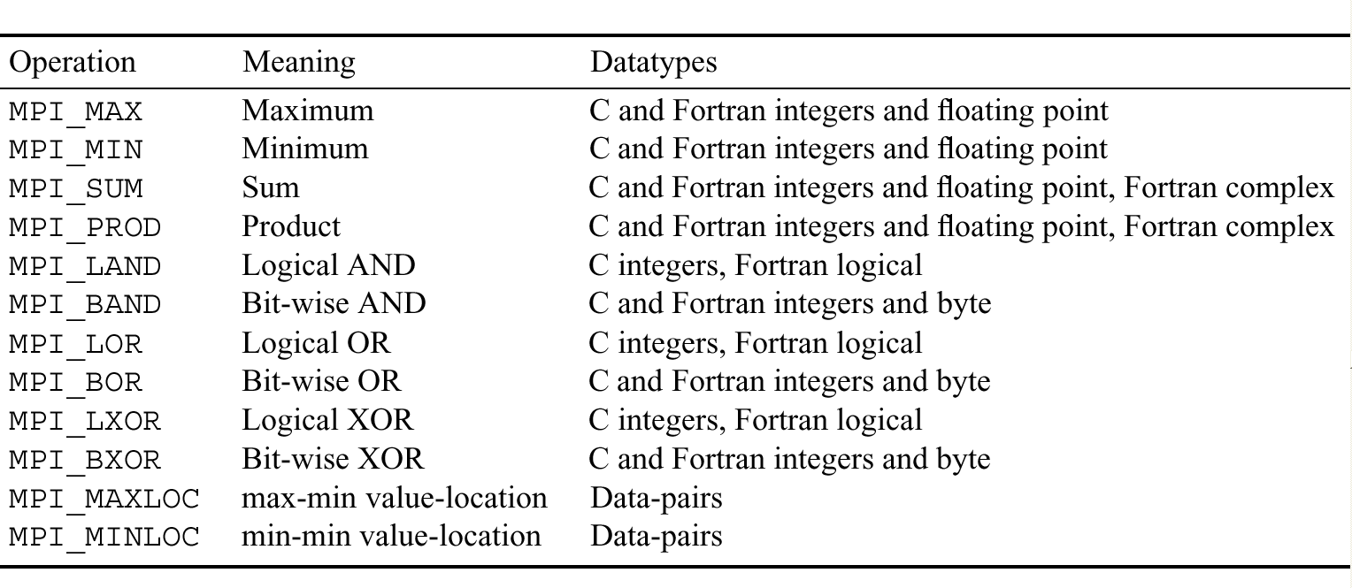
REDUCTION MPI_OP’s…

Slide 50
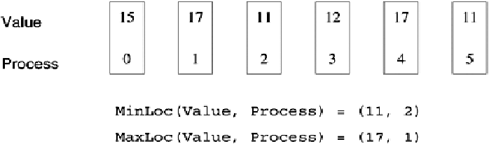
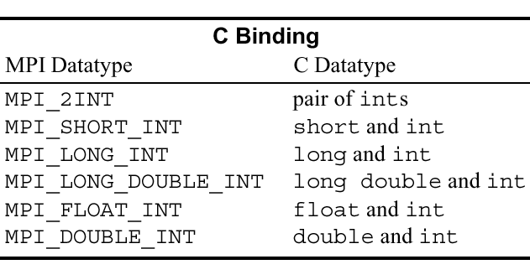
REDUCTION MPI_OP’s…
An example use of the MPI_MINLOC and MPI_MAXLOC operators and
the Data Type pairs used for MPI_MINLOC and MPI_MAXLOC

Slide 51
BCast and Reduce Example: PI
#include <stdio.h>
#include "mpi.h"
main(int argc, char **argv)
{
int done = 0, n=0, myid, tag, mypid, numprocs, i, rc;
double PI25DT = 3.141592653589793238462643;
double mypi, pi, h, sum, x, a;
MPI_Status status;
char message[20];
MPI_Init(&argc, &argv);
MPI_Comm_size(MPI_COMM_WORLD, &numprocs);
MPI_Comm_rank(MPI_COMM_WORLD, &myid);
tag = 100;
printf("Broadcast oncesi rakam = %d \n",n);
if (myid==0) { printf("Dagitilacak sayi 'n' girin: %d (0 for quit) ",n);
scanf("%d", &n);}
printf("Simdi Broadcast Basladi...\n");
MPI_Bcast(&n, 1, MPI_INT, 0, MPI_COMM_WORLD);
if (n==0) exit(0);
printf("Broadcast ile alinan rakam = %d \n",n);
h = 1.0/ (double) n; sum = 0.0;
for (i=myid+1; i<=n; i +=numprocs)
{ x = h * ((double)i-0.5);
sum += 4.0 / (1.0 + x*x); }
mypi = h * sum;
MPI_Reduce(&mypi, &pi, 1, MPI_DOUBLE, MPI_SUM,0, MPI_COMM_WORLD);
if (myid==0) printf("pi is approximately %.16f, Error is %.16f \n", pi, fabs(pi-PI25DT));
MPI_Finalize();
}

Slide 52
PREFIX
The prefix-sum operation is performed in MPI using the MPI_Scan function.
int MPI_Scan(void *sendbuf, void *recvbuf, int count, MPI_Datatype datatype, MPI_Op op, MPI_Comm comm)
MPI_Scan performs a prefix reduction of the data stored in the buffer sendbuf at each process and returns the result in the buffer recvbuf.
The receive buffer of the process with rank i will store, at the end of the operation, the reduction of the send buffers of the processes whose ranks range from 0 up to and including i.
The type of supported operations (i.e., op) as well as the restrictions on the various arguments of MPI_Scan are the same as those for the reduction operation MPI_Reduce

Slide 53
Prefix Reduction
#include <stdio.h>
#include "mpi.h"
int main(int argc, char** argv)
{ int i, N, noprocs, nid, hepsi;
float sum = 0, Gsum;
MPI_Init(&argc, &argv);
MPI_Comm_rank(MPI_COMM_WORLD, &nid);
MPI_Comm_size(MPI_COMM_WORLD, &noprocs);
if(nid == 0){ printf("Please enter the number of terms N -> "); scanf("%d",&N); }
MPI_Bcast(&N,1,MPI_INT,0,MPI_COMM_WORLD);
for(i = nid; i < N; i += noprocs)
if(i % 2)
sum -= (float) 1 / (i + 1);
else
sum += (float) 1 / (i + 1);
MPI_Reduce(&sum,&Gsum,1,MPI_FLOAT,MPI_SUM,0,MPI_COMM_WORLD);
if(nid == 0) printf("An estimate of ln(2) is %f \n",Gsum);
hepsi = nid;
printf("My rank is %d Hepsi =%d \n",nid,hepsi);
MPI_Allreduce(&nid,&hepsi,1,MPI_INT,MPI_SUM,MPI_COMM_WORLD);
printf("After All Reduce My rank is %d Hepsi =%d \n",nid,hepsi);
hepsi = nid;
MPI_Scan(&nid,&hepsi,1,MPI_INT,MPI_SUM,MPI_COMM_WORLD);
printf("After Prefix Reduction My rank is %d Hepsi =%d \n",nid,hepsi);
MPI_Finalize();
return 0;
}

Slide 54
GATHER
The gather operation is performed in MPI using the MPI_Gather function.
int MPI_Gather(void *sendbuf, int sendcount, MPI_Datatype senddatatype, void *recvbuf, int recvcount, MPI_Datatype recvdatatype, int target, MPI_Comm comm)
Each process, including the target process, sends the data stored in the array sendbuf to the target process. As a result, if p is the number of processors in the communication comm, the target process receives a total of p buffers.
The data is stored in the array recvbuf of the target process, in a rank order. That is, the data from process with rank i are stored in the recvbuf starting at location i * sendcount (assuming that the array recvbuf is of the same type as recvdatatype).

Slide 55
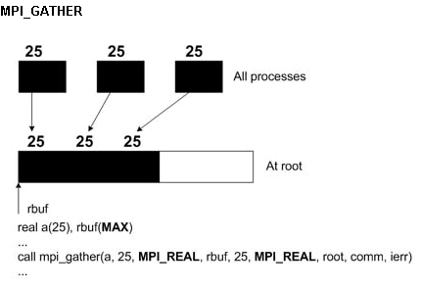
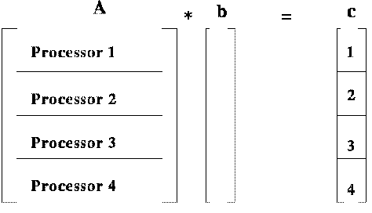
GATHER Sample Code
double a[100,25],b[100],cpart[25],ctotal[100];
int root;
root=0;
for(i=0;i<25;i++)
{ cpart[i]=0;
for(k=0;k<100;k++) cpart[i]=cpart[i]+a[k,i]*b[k];
} MPI_Gather(cpart,25,MPI_DOUBLE,ctotal,25,MPI_DOUBLE,root,MPI_COMM_WORLD);
The problem associated with the following sample code is the multiplication of a matrix A, size 100x100, by a vector B of length 100. Since this example uses 4 tasks, each task will work on its own chunk of 25 rows of A. B is the same for each task. The vector C will have 25 elements calculated by each task, stored in cpart. The MPI_Gather routine will retrieve cpart from each task and store the result in ctotal, which is the complete vector C.

Slide 56
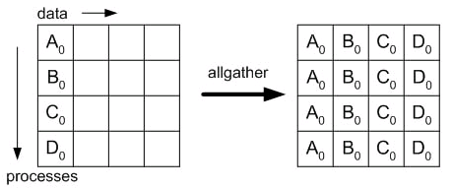
GATHER (All)
MPI also provides the MPI_Allgather function in which the data are gathered to all the processes and not only at the target process.
int MPI_Allgather(void *sendbuf, int sendcount, MPI_Datatype senddatatype, void *recvbuf, int recvcount, MPI_Datatype recvdatatype, MPI_Comm comm)
The meanings of the various parameters are similar to those for MPI_Gather; however, each process must now supply a recvbuf array that will store the gathered data.

Slide 57
ALLGATHER Sample Code
double a[100,25], b[100], cpart[25],ctotal[100];
for(i=0;i<25;i++)
{
cpart[i]=0;
for(k=0;k<100;k++)
{
cpart[i]=cpart[i]+a[k,i]*b[k];
}
}
MPI_Allgather(cpart,25,MPI_REAL,ctotal,25,MPI_REAL,MPI_COMM_WORLD);

Slide 58
GATHER (Other Variants)
In addition to the MPI_Gather and MPI_Allgather versions of the gather operation, in which the sizes of the arrays sent by each process are the same, MPI also provides versions in which the size of the arrays can be different.
MPI refers to these operations as the vector variants. They are provided by the functions MPI_Gatherv and MPI_Allgatherv, respectively.
int MPI_Gatherv(void *sendbuf, int sendcount, MPI_Datatype senddatatype, void *recvbuf, int *recvcounts, int *displs, MPI_Datatype recvdatatype, int target, MPI_Comm comm)
int MPI_Allgatherv(void *sendbuf, int sendcount, MPI_Datatype senddatatype, void *recvbuf, int *recvcounts, int *displs, MPI_Datatype recvdatatype, MPI_Comm comm)

Slide 59
GATHER (Other Variants)
int MPI_Gatherv(void *sendbuf, int sendcount, MPI_Datatype senddatatype, void *recvbuf, int *recvcounts, int *displs, MPI_Datatype recvdatatype, int target, MPI_Comm comm)
int MPI_Allgatherv(void *sendbuf, int sendcount, MPI_Datatype senddatatype, void *recvbuf, int *recvcounts, int *displs, MPI_Datatype recvdatatype, MPI_Comm comm)
These functions allow a different number of data elements to be sent by each process by replacing the recvcount parameter with the array recvcounts. The amount of data sent by process i is equal to recvcounts[i]. Note that the size of recvcounts is equal to the size of the communicator comm.
The array parameter displs, which is also of the same size, is used to determine where in recvbuf the data sent by each process will be stored. In particular, the data sent by process i are stored in recvbuf starting at location displs[i]. Note that, as opposed to the non-vector variants, the sendcount parameter can be different for different processes.

Slide 60
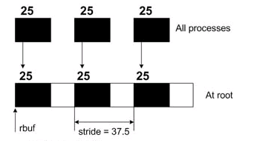
GATHERV Sample Code (Fortran)
real a(25), rbuf(MAX)
integer displs(NX), rcounts(NX), nsize
do i= 1, nsize
displs(i) = (i-1)*stride
rcounts(i) = 25
enddo
call mpi_gatherv(a,25,MPI_REAL,rbuf,rcounts,displs, & MPI_REAL,root,comm,ierr)
MPI_GATHERV and MPI_SCATTERV are the variable-message-size versions of MPI_GATHER and MPI_SCATTER

Slide 61
SCATTER
The scatter operation is performed in MPI using the MPI_Scatter function.
int MPI_Scatter(void *sendbuf, int sendcount, MPI_Datatype senddatatype, void *recvbuf, int recvcount, MPI_Datatype recvdatatype, int source, MPI_Comm comm)
The source process sends a different part of the send buffer sendbuf to each processes, including itself. The data that are received are stored in recvbuf.
Process i receives sendcount contiguous elements of type senddatatype starting from the i * sendcount location of the sendbuf of the source process (assuming that sendbuf is of the same type as senddatatype).
MPI_Scatter must be called by all the processes with the same values for the sendcount, senddatatype, recvcount, recvdatatype, source, and comm arguments. Note again that sendcount is the number of elements sent to each individual process.

Slide 62
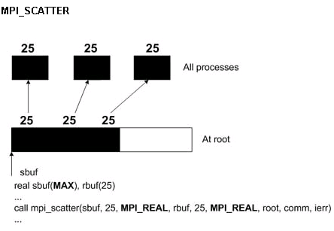
SCATTER Sample Code
double cpart[25],ctotal[100];
int root;
root=0;
MPI_Scatter(ctotal,25,MPI_DOUBLE, cpart,25,MPI_DOUBLE,root,MPI_COMM_WORLD);

Slide 63
SCATTER (Variant)
Similarly to the gather operation, MPI provides a vector variant of the scatter operation, called MPI_Scatterv, that allows different amounts of data to be sent to different processes.
int MPI_Scatterv(void *sendbuf, int *sendcounts, int *displs, MPI_Datatype senddatatype, void *recvbuf, int recvcount, MPI_Datatype recvdatatype, int source, MPI_Comm comm)
As we can see, the parameter sendcount has been replaced by the array sendcounts that determines the number of elements to be sent to each process. In particular, the target process sends sendcounts[i] elements to process i.
Also, the array displs is used to determine where in sendbuf these elements will be sent from. In particular, if sendbuf is of the same type is senddatatype, the data sent to process i start at location displs[i] of array sendbuf. Both the sendcounts and displs arrays are of size equal to the number of processes in the communicator. Note that by appropriately setting the displs array we can use MPI_Scatterv to send overlapping regions of sendbuf.

Slide 64
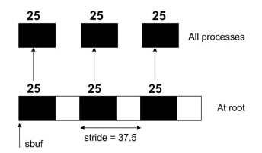
SCATTERV Sample Code (Fortran)
real a(25), sbuf(MAX)
integer displs(NX), scounts(NX), nsize
do i= 1, nsize
displs(i) = (i-1)*stride
rcounts(i) = 25
enddo
call mpi_scatterv(sbuf,scounts,displs,MPI_REAL,a,25, & MPI_REAL,root,comm,ierr)
MPI_GATHERV and MPI_SCATTERV are the variable-message-size versions of MPI_GATHER and MPI_SCATTER

Slide 65
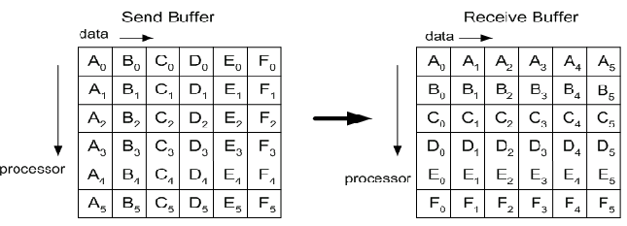
All-to-All
The all-to-all personalized communication operation is performed in MPI by using the MPI_Alltoall function.
int MPI_Alltoall(void *sendbuf, int sendcount, MPI_Datatype senddatatype, void *recvbuf, int recvcount, MPI_Datatype recvdatatype, MPI_Comm comm)
Each process sends a different portion of the sendbuf array to each other process, including itself. Each process sends to process i sendcount contiguous elements of type senddatatype starting from the i * sendcount location of its sendbuf array. The data that are received are stored in the recvbuf array.
Each process receives from process i recvcount elements of type recvdatatype and stores them in its recvbuf array starting at location i * recvcount. MPI_Alltoall must be called by all the processes with the same values for the sendcount, senddatatype, recvcount, recvdatatype, and comm arguments. Note that sendcount and recvcount are the number of elements sent to, and received from, each individual process

Slide 66
All-to-All (Variant)
MPI also provides a vector variant of the all-to-all personalized communication operation called MPI_Alltoallv that allows different amounts of data to be sent to and received from each process.
int MPI_Alltoallv(void *sendbuf, int *sendcounts, int *sdispls MPI_Datatype senddatatype, void *recvbuf, int *recvcounts, int *rdispls, MPI_Datatype recvdatatype, MPI_Comm comm)
The parameter sendcounts is used to specify the number of elements sent to each process, and the parameter sdispls is used to specify the location in sendbuf in which these elements are stored. In particular, each process sends to process i, starting at location sdispls[i] of the array sendbuf, sendcounts[i] contiguous elements.
The parameter recvcounts is used to specify the number of elements received by each process, and the parameter rdispls is used to specify the location in recvbuf in which these elements are stored. In particular, each process receives from process i recvcounts[i] elements that are stored in contiguous locations of recvbuf starting at location rdispls[i]. MPI_Alltoallv must be called by all the processes with the same values for the senddatatype, recvdatatype, and comm arguments.

Slide 67
MPI Programming Part III

Slide 68
Cartesian Topology
Cartesian Constructor Function
MPI_Cart_create(MPI_Comm comm_old, int ndims, int *dims, int *periods, int reorder, MPI_Comm *comm_cart)
Ndims: Number of dimensions
Dims: Number of processes per coordinate direction
Periods: Periodicity information
Own_position: Own_poisition in grid
MPI_CART_CREATE can be used to describe Cartesian structures of arbitrary dimension.
For each coordinate direction one specifies whether the process structure is periodic or not.
For a 1D topology, it is linear if it is not periodic and a ring if it is periodic.
For a 2D topology, it is a rectangle, cylinder, or torus as it goes from non-periodic to periodic in one dimension to fully periodic.
Note that an n -dimensional hypercube is an n -dimensional torus with 2 processes per coordinate direction. Thus, special support for hypercube structures is not necessary.

Slide 69
Cartesian Topology
MPI_Cart_create(MPI_Comm comm_old, int ndims, int *dims, int *periods, int reorder, MPI_Comm *comm_cart)
MPI_CART_CREATE returns a handle to a new communicator to which the Cartesian topology information is attached.
In analogy to the function MPI_COMM_CREATE, no cached information propagates to the new communicator. Also, this function is collective. As with other collective calls, the program must be written to work correctly, whether the call synchronizes or not.
If reorder = false then the rank of each process in the new group is identical to its rank in the old group. Otherwise, the function may reorder the processes (possibly so as to choose a good embedding of the virtual topology onto the physical machine).
If the total size of the Cartesian grid is smaller than the size of the group of comm_old, then some processes are returned MPI_COMM_NULL, in analogy to MPI_COMM_SPLIT. MPI_COMM_NULL The call is erroneous if it specifies a grid that is larger than the group size.

Slide 70
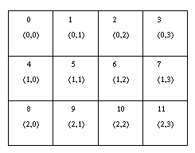
Cartesian Convenience Function:MPI_DIMS_CREATE
For Cartesian topologies, the function MPI_DIMS_CREATE helps the user select a balanced distribution of processes per coordinate direction, depending on the number of processes in the group to be balanced and optional constraints that can be specified by the user.
One possible use of this function is to partition
all the processes (the size of MPI_COMM_WORLD's
group) into an n -dimensional topology.
MPI_Dims_create(int nnodes, int ndims, int *dims)
The entries in the array dims are set to describe a Cartesian grid with ndims dimensions and a total of nnodes nodes. The dimensions are set to be as close to each other as possible, using an appropriate divisibility algorithm. The caller may further constrain the operation of this routine by specifying elements of array dims. If dims[i] is set to a positive number, the routine will not modify the number of nodes in dimension i; only those entries where dims[i] = 0 are modified by the call.

Slide 71
Cartesian Inquiry Functions
Once a Cartesian topology is set up, it may be necessary to inquire about the topology. These functions are given below and are all local calls.
MPI_Cartdim_get(MPI_Comm comm, int *ndims)
MPI_CARTDIM_GET returns the number of dimensions of the Cartesian structure associated with comm. This can be used to provide the other Cartesian inquiry functions with the correct size of arrays.
MPI_Cart_get(MPI_Comm comm, int maxdims, int *dims, int *periods, int *coords)
MPI_CART_GET returns information on the Cartesian topology associated with comm. maxdims must be at least ndims as returned by MPI_CARTDIM_GET.

Slide 72
CARTESIAN TOPOLOGY SAMPLE(Topology query)
/******************************************************************************
* MPI tutorial example code: Cartesian Virtual Topology of HyperCube
* AUTHOR: Muhammed Cinsdikici (virtualtop3.c)
******************************************************************************/
#include "mpi.h"
#include <stdio.h>
#define SIZE 8
#define UP 0
#define DOWN 1
#define LEFT 2
#define RIGHT 3
int main(int argc,char *argv[])
{ int numtasks, rank, source, dest, outbuf, i, tag=1, inbuf[4] = { MPI_PROC_NULL, MPI_PROC_NULL, MPI_PROC_NULL, MPI_PROC_NULL,}, nbrs[4], dims[2]={2,2,2}, periods[2]={0,0,0}, reorder=0, coords[3];
MPI_Request reqs[8]; MPI_Status stats[8]; MPI_Comm cartcomm;
MPI_Init(&argc,&argv);
MPI_Comm_size(MPI_COMM_WORLD, &numtasks);
if (numtasks == SIZE) {
MPI_Cart_create(MPI_COMM_WORLD, 2, dims, periods, reorder, &cartcomm);
MPI_Comm_rank(cartcomm, &rank);
MPI_Cart_coords(cartcomm, rank, 2, coords);
MPI_Cartdim_get(cartcomm, &ndims);
printf("My Cartesian Topology RANK: %d.\n",rank);
printf("Cartesian Topology MAX dimensions %d.\n",ndims);
MPI_Cart_get(cartcomm, ndims, ndims2, periods2, coord2);
printf("Cartesian Topology \n Dimensions: %dx%dx%d.\n Periods: %dx%dx%d \n Coords: %dx%dx%d \n",
ndims2[0],ndims2[1],ndims2[2],periods2[0],periods2[1],periods2[2],coord2[0],coord2[1],coord2[2]);
}
else printf("Must specify %d tasks. Terminating.\n",SIZE);
MPI_Finalize();
}

Slide 73
Cartesian Translator Functions
The functions in this section translate to/from the rank and the Cartesian topology coordinates. These calls are local
MPI_Cart_rank(MPI_Comm comm, int *coords, int *rank)
For a process group with Cartesian structure, the function MPI_CART_RANK translates the logical process coordinates to process ranks as they are used by the point-to-point routines. coords is an array of size ndims as returned by MPI_CARTDIM_GET. For the example in Figure ,coords = (1,2) would return rank = 6
For dimension i with periods(i) = true, if the coordinate, coords(i), is out of range, that is, coords(i) < 0 or coords(i) >= dims(i), it is shifted back to the interval 0 <= coords(i) < dims(i) automatically. If the topology in Figure is periodic in both dimensions (torus), then coords = (4,6) would also return rank = 6. Out-of-range coordinates are erroneous for non-periodic dimensions

Slide 74
Cartesian Translator Functions
MPI_Cart_coords (MPI_Comm comm, int rank, int maxdims, int *coords)
MPI_CART_COORDS is the rank-to-coordinates translator. It is the inverse mapping of MPI_CART_RANK. maxdims is at least as big as ndims as returned by MPI_CARTDIM_GET. For the example in Figure , rank = 6 would return coords = (1,2)

Slide 75
CARTESIAN TOPOLOGY SAMPLE (Coordinates)
/******************************************************************************
* MPI tutorial example code: Cartesian Virtual Topology of HyperCube
* AUTHOR: Muhammed Cinsdikici (virtualtop2.c)
******************************************************************************/
#include "mpi.h"
#include <stdio.h>
#define SIZE 8
#define UP 0
#define DOWN 1
#define LEFT 2
#define RIGHT 3
int main(int argc,char *argv[])
{ int numtasks, rank, source, dest, outbuf, i, tag=1, inbuf[4] = { MPI_PROC_NULL, MPI_PROC_NULL, MPI_PROC_NULL, MPI_PROC_NULL,}, nbrs[4], dims[2]={2,2,2}, periods[2]={0,0,0}, reorder=0, coords[3];
MPI_Request reqs[8];
MPI_Status stats[8];
MPI_Comm cartcomm;
MPI_Init(&argc,&argv);
MPI_Comm_size(MPI_COMM_WORLD, &numtasks);
if (numtasks == SIZE) {
MPI_Cart_create(MPI_COMM_WORLD, 2, dims, periods, reorder, &cartcomm);
MPI_Comm_rank(cartcomm, &rank);
MPI_Cart_coords(cartcomm, rank, 2, coords);
MPI_Cart_shift(cartcomm, 0, 1, &nbrs[UP], &nbrs[DOWN]);
MPI_Cart_shift(cartcomm, 1, 1, &nbrs[LEFT], &nbrs[RIGHT]);
printf("rank= %d coords= %d %d %d \n", rank,coords[0],coords[1], coords[2]);
}
else printf("Must specify %d tasks. Terminating.\n",SIZE);
MPI_Finalize();
}

Slide 76
Cartesian Shift Function
If the process topology is a Cartesian structure, a MPI_SENDRECV operation is likely to be used along a coordinate direction to perform a shift of data. As input, MPI_SENDRECV takes the rank of a source process for the receive, and the rank of a destination process for the send. A Cartesian shift operation is specified by the coordinate of the shift and by the size of the shift step (positive or negative). The function MPI_CART_SHIFT inputs such specification and returns the information needed to call MPI_SENDRECV. The function MPI_CART_SHIFT is local.
MPI_Cart_shift(MPI_Comm comm, int direction, int disp, int *rank_source, int *rank_dest)
The direction argument indicates the dimension of the shift, i.e., the coordinate whose value is modified by the shift. The coordinates are numbered from 0 to ndims-1, where ndims is the number of dimensions

Slide 77
Cartesian Shift Function
MPI_Cart_shift(MPI_Comm comm, int direction, int disp, int *rank_source, int *rank_dest)
Depending on the periodicity of the Cartesian group in the specified coordinate direction, MPI_CART_SHIFT provides the identifiers for a circular or an end-off shift. In the case of an end-off shift, the value MPI_PROC_NULL may be returned in MPI_PROC_NULL rank_source and/or rank_dest, indicating that the source and/or the destination for the shift is out of range. This is a valid input to the sendrecv functions.
Neither MPI_CART_SHIFT, nor MPI_SENDRECV are collective functions. It is not required that all processes in the grid call MPI_CART_SHIFT with the same direction and disp arguments, but only that sends match receives in the subsequent calls to MPI_SENDRECV.

Slide 78
CARTESIAN TOPOLOGY SAMPLE (send&recv, mesh)
/******************************************************************************
* MPI tutorial example code: Cartesian Virtual Topology
* FILE: cartesian.c
* AUTHOR: Blaise Barney
* LAST REVISED (virtualtop.c)
******************************************************************************/
#include "mpi.h"
#include <stdio.h>
#define SIZE 16
#define UP 0
#define DOWN 1
#define LEFT 2
#define RIGHT 3
int main(argc,argv)
int argc;
char *argv[]; {
int numtasks, rank, source, dest, outbuf, i, tag=1,
inbuf[4]={MPI_PROC_NULL,MPI_PROC_NULL,MPI_PROC_NULL,MPI_PROC_NULL,},
nbrs[4], dims[2]={4,4},
periods[2]={0,0}, reorder=0, coords[2];

Slide 79
CARTESIAN TOPOLOGY SAMPLE (send&recv, mesh)
MPI_Request reqs[8];
MPI_Status stats[8];
MPI_Comm cartcomm;
MPI_Init(&argc,&argv);
MPI_Comm_size(MPI_COMM_WORLD, &numtasks);
if (numtasks == SIZE) {
MPI_Cart_create(MPI_COMM_WORLD, 2, dims, periods, reorder, &cartcomm);
MPI_Comm_rank(cartcomm, &rank);
MPI_Cart_coords(cartcomm, rank, 2, coords);
MPI_Cart_shift(cartcomm, 0, 1, &nbrs[UP], &nbrs[DOWN]);
MPI_Cart_shift(cartcomm, 1, 1, &nbrs[LEFT], &nbrs[RIGHT]);
outbuf = rank;
for (i=0; i<4; i++) {
dest = nbrs[i];
source = nbrs[i];
MPI_Isend(&outbuf, 1, MPI_INT, dest, tag, MPI_COMM_WORLD, &reqs[i]);
MPI_Irecv(&inbuf[i], 1, MPI_INT, source, tag, MPI_COMM_WORLD, &reqs[i+4]);
}
MPI_Waitall(8, reqs, stats);
printf("rank= %d coords= %d %d neighbors(u,d,l,r)= %d %d %d %d inbuf(u,d,l,r)= %d %d %d %d\n", rank,coords[0],coords[1],nbrs[UP],nbrs[DOWN],nbrs[LEFT],inbuf[UP],inbuf[DOWN],inbuf[LEFT],inbuf[RIGHT]);
}
else
printf("Must specify %d tasks. Terminating.\n",SIZE);
MPI_Finalize();
}

Slide 80
Cartesian Partitioning Functions
int MPI_Comm_split(MPI_Comm comm, int color, int key, MPI_Comm *newcomm)
This function is a collective operation, and thus needs to be called by all the processes in the communicator comm.
The function takes color and key as input parameters in addition to the communicator, and partitions the group of processes in the communicator comm into disjoint subgroups.
Each subgroup contains all processes that have supplied the same value for the color parameter. Within each subgroup, the processes are ranked in the order defined by the value of the key parameter, with ties broken according to their rank in the old communicator (i.e., comm).

Slide 81
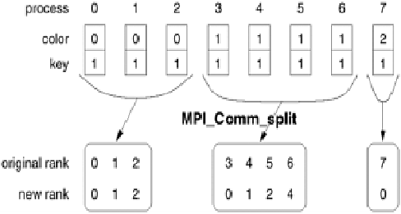
Cartesian Partitioning Functions
int MPI_Comm_split(MPI_Comm comm, int color, int key, MPI_Comm *newcomm)
A new communicator for each subgroup is returned in the newcomm parameter. Figure shows an example of splitting a communicator using the MPI_Comm_split function. If each process called MPI_Comm_split using the values of parameters color and key as shown in Figure, then three communicators will be created, containing processes {0, 1, 2}, {3, 4, 5, 6}, and {7}, respectively.

Slide 82
Cartesian Partition Function
int MPI_Cart_sub(MPI_Comm comm_cart, int *keep_dims, MPI_Comm *comm_subcart)
If a Cartesian topology has been created with MPI_CART_CREATE, Function MPI_CART_SUB can be used to partition the communicator group into subgroups that form lower-dimensional Cartesian subgrids and build for each subgroup a communicator with the associated subgrid Cartesian topology.
For example, we can partition a two-dimensional topology into groups, each consisting of the processes along the row or column of the topology.
This call is collective.

Slide 83
Cartesian Partition Function
int MPI_Cart_sub(MPI_Comm comm_cart, int *keep_dims, MPI_Comm *comm_subcart)
The array keep_dims is used to specify how the Cartesian topology is partitioned. In particular, if keep_dims[i] is true (non-zero value in C) then the ith dimension is retained in the new sub-topology.
For example, consider a three-dimensional topology of size 2 x 4 x 7.
  If keep_dims is {true, false, true}, then the original topology is split into four two-dimensional sub-topologies of size 2 x 7, as illustrated in Figure
  If keep_dims is {false, false, true}, then the original topology is split into eight one-dimensional topologies of size seven, illustrated in Figure.

Slide 84
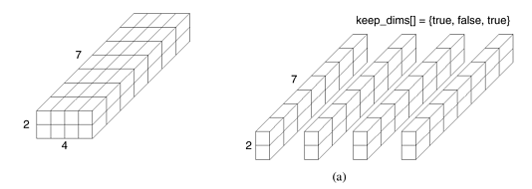
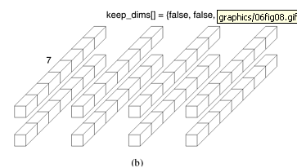
Cartesian Partition Function
Splitting a Cartesian topology of size 2 x 4 x 7 into
  (a) four subgroups of size 2 x 1 x 7,
  (b) eight subgroups of size 1 x 1 x 7.
  Note that the number of sub-topologies created is equal to the product of the number of processes along the dimensions that are not being retained. The original topology is specified by the communicator comm_cart, and the returned communicator comm_subcart stores information about the created sub-topology. Only a single communicator is returned to each process, and for processes that do not belong to the same sub-topology, the group specified by the returned communicator is different

Slide 85
Cartesian Low-level Functions
Typically, the functions already presented are used to create and use Cartesian topologies.
However, some applications may want more control over the process. MPI_CART_MAP returns the Cartesian map recommended by the MPI system, in order to map well the virtual communication graph of the application on the physical machine topology.
This call is collective.
MPI_Cart_map(MPI_Comm comm, int ndims, int *dims, int *periods, int *newrank)

Slide 86
MatrixVectorMultiply_2D(int n, double *a, double *b, double *x, MPI_Comm comm)
{ int ROW=0, COL=1; /* Improve readability */
int i, j, nlocal;
double *px; /* Will store partial dot products */
int npes, dims[2], periods[2], keep_dims[2];
int myrank, my2drank, mycoords[2];
int other_rank, coords[2];
MPI_Status status;
MPI_Comm comm_2d, comm_row, comm_col;
/* Get information about the communicator */
MPI_Comm_size(comm, &npes);
MPI_Comm_rank(comm, &myrank);
/* Compute the size of the square grid */
dims[ROW] = dims[COL] = sqrt(npes);
nlocal = n/dims[ROW];
/* Allocate memory for the array that will hold the partial dot-products */
px = malloc(nlocal*sizeof(double));
/* Set up the Cartesian topology and get the rank & coordinates of the process in this topology */

Slide 87
periods[ROW] = periods[COL] = 1; /* Set the periods for wrap-around connections */
MPI_Cart_create(MPI_COMM_WORLD, 2, dims, periods, 1, &comm_2d);
MPI_Comm_rank(comm_2d, &my2drank); /* Get my rank in the new topology */
MPI_Cart_coords(comm_2d, my2drank, 2, mycoords); /* Get my coordinates */
/* Create the row-based sub-topology */
keep_dims[ROW] = 0;
keep_dims[COL] = 1;
MPI_Cart_sub(comm_2d, keep_dims, &comm_row);
/* Create the column-based sub-topology */
keep_dims[ROW] = 1; keep_dims[COL] = 0;
MPI_Cart_sub(comm_2d, keep_dims, &comm_col);
/* Redistribute the b vector. */
/* Step 1. The processors along the 0th column send their data to the diagonal processors */
if (mycoords[COL] == 0 && mycoords[ROW] != 0) { /* I'm in the first column */
coords[ROW] = mycoords[ROW];
coords[COL] = mycoords[ROW];
MPI_Cart_rank(comm_2d, coords, &other_rank);
MPI_Send(b, nlocal, MPI_DOUBLE, other_rank, 1, comm_2d); }

Slide 88
if (mycoords[ROW] == mycoords[COL] && mycoords[ROW] != 0) {
coords[ROW] = mycoords[ROW];
coords[COL] = 0;
MPI_Cart_rank(comm_2d, coords, &other_rank);
MPI_Recv(b, nlocal, MPI_DOUBLE, other_rank, 1, comm_2d, &status);
}
/* Step 2. The diagonal processors perform a column-wise broadcast */
coords[0] = mycoords[COL];
MPI_Cart_rank(comm_col, coords, &other_rank);
MPI_Bcast(b, nlocal, MPI_DOUBLE, other_rank, comm_col);
/* Get into the main computational loop */
for (i=0; i<nlocal; i++) { px[i] = 0.0;
for (j=0; j<nlocal; j++) px[i] += a[i*nlocal+j]*b[j]; }
/* Perform the sum-reduction along the rows to add up the partial dot-products */
coords[0] = 0;
MPI_Cart_rank(comm_row, coords, &other_rank);
MPI_Reduce(px, x, nlocal, MPI_DOUBLE, MPI_SUM, other_rank, comm_row);
MPI_Comm_free(&comm_2d); /* Free up communicator */
MPI_Comm_free(&comm_row); /* Free up communicator */
MPI_Comm_free(&comm_col); /* Free up communicator */
free(px);
}

